Slide 1
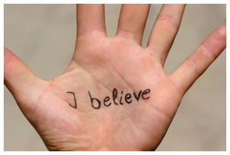
Faith Quiz

Slide 2
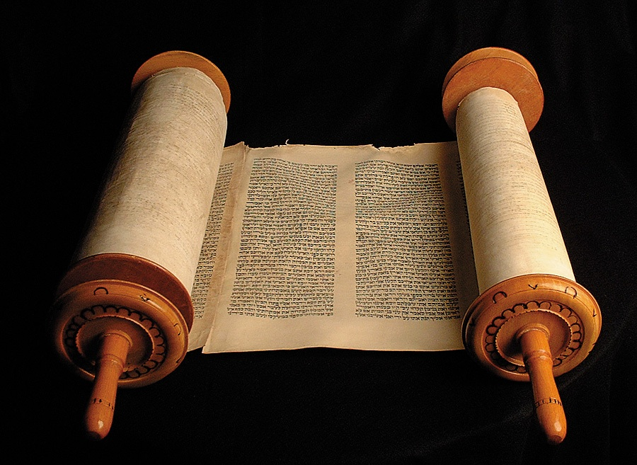
How many times does the word ‘faith’ appear in the Old Testament (N.I.V.)?
16
26
36

Slide 3
16

Slide 4

How many times does the word ‘faith’ appear in the New Testament (N.I.V.)?
54
154
254

Slide 5
234

Slide 6
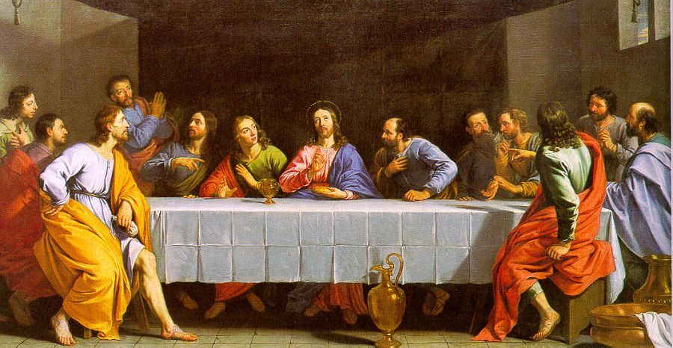
How many times did Jesus admonish the disciples for having ‘little faith’?
2
4
6

Slide 7
4

Slide 8
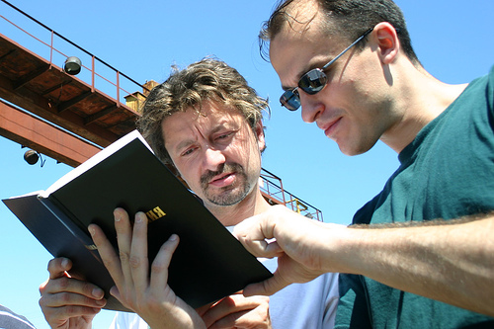
Which Gospel records all four occasions?
Matthew
Luke
John

Slide 9
Matthew

Slide 10
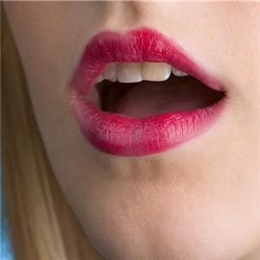
Who asked Jesus to increase their faith?
Crowd
Apostles
James & John

Slide 11
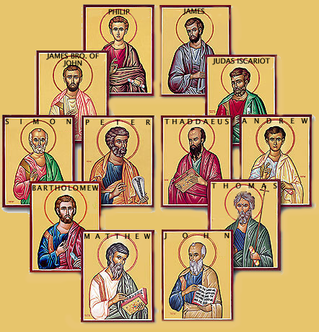
Apostles
(Luke chapter 17 verse 5)

Slide 12
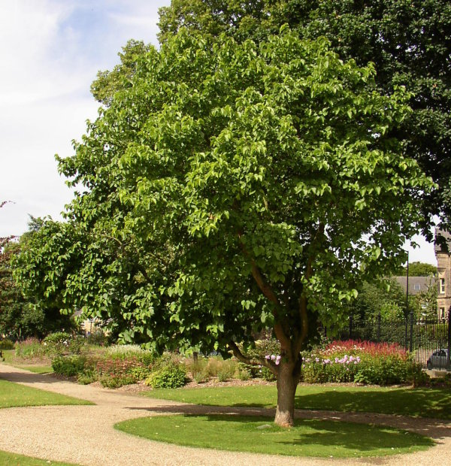
Jesus said to them; “If you have faith as small as a mustard seed, you can say to this ______ tree”?
Sycamore
Mulberry
Cedar

Slide 13
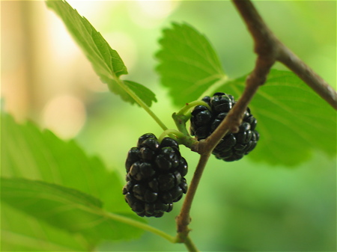
Mulberry

Slide 14
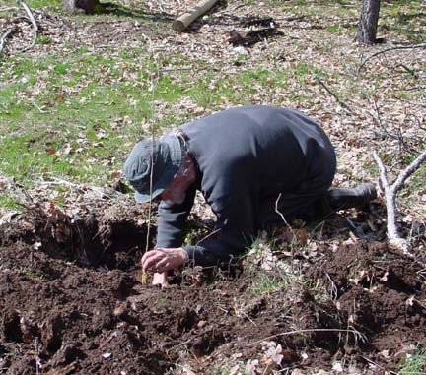
Quotation continued: “Be uprooted and planted” where?
Mountain top
Sea
Desert

Slide 15
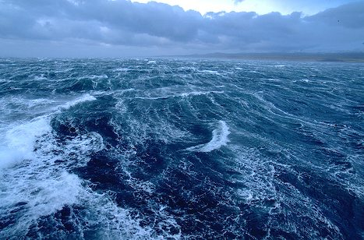
Sea

Slide 16
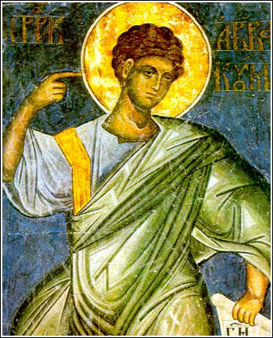
who wrote; “The just shall live by faith”?
Zephaniah
Habakkuk
Malachi

Slide 17
Habakkuk (2:4)

Slide 18
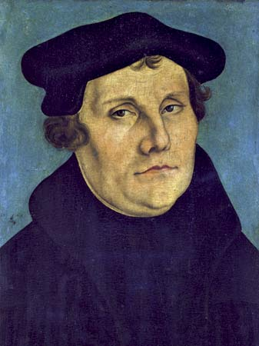
Martin Luther “I felt myself reborn and to have gone through open doors into paradise”. But in what year?
1419
1519
1619

Slide 19
1519

Slide 20
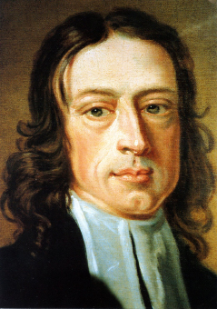
Which Wesley 200yrs later was converted by Luther’s preface to the book of Romans
John
Charles
Richard

Slide 21
John Wesley

